Slide 1

Twitter Sentiment Analysis
Gabe Smith
Phone: (480) 823-4262
Email: gabessmith432@gmail.com

Slide 2

Why Sentiment Analysis?
Sentiment analysis is an extremely useful tool for finding overall opinion regarding a specific topic. This is especially useful on social media, where people post their true feelings around a certain subject
Sentiment analysis is being used in various industries/settings:
Government officials analyzing public view of recent policy announcements, legislation changes or campaign messages
Major corporations gauging viewership of their product, and understanding the success of recent marketing/commercial campaigns
As social media continues to grow, sentiment analysis will only continue to grow in giving timely feedback regarding any type of subject

Slide 3
Existing Research/Previous Approaches
Concept-level Sentiment Analysis based on Lexicon (looking at the sentiment ordering of words) and Learning (machine learning), computing probability p in [-1,1] then mapping to values 1 to 5¹
Creating machine learning for fuzzy ontology domain trees (trees mapping “fuzzy”/sentimentally unclear terms to specific sentiment based on the training data)²
Using unigram model (extracts only descriptive adjectives from specific sentence) then using supervised learning to predict positive/negative polarity
Mudinas, Zhang, Levene: Combining Lexicon and Learning based Approaches for Concept-Level Sentiment Analysis. https://dl.acm.org/doi/pdf/10.1145/2346676.2346681
L. Liu, X. Nie,and H. Wang, Toward a Fuzzy Domain Sentiment Ontology Tree for Sentiment Analysis. https://ieeexplore.ieee.org/document/6469930
G. Gautam, D. yadav. Sentiment Analysis of Twitter Data using Machine Learning Approaches and Sentiment Analysis. https://ieeexplore.ieee.org/document/6897213

Slide 4



Data Sources, Programming Languages, Toolkits
Data: Twitter Sentiment Analysis Dataset (1,600,000 tweets, preclassified as positive or negative)
Programming Language: Python, using Jupyter Notebook and Google Colab environments
Toolkits: various machine learning models and vectorize functions in Scikit-Learn Python library

Slide 5
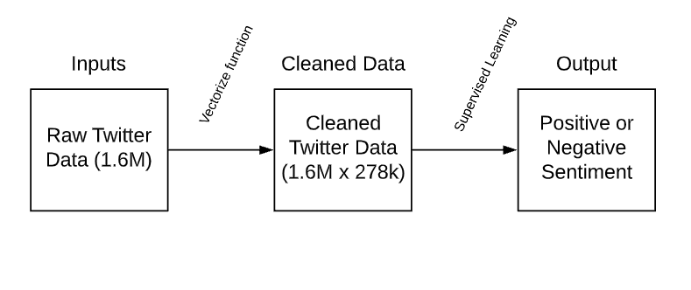
Solution Workflow

Slide 6
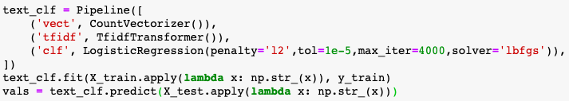
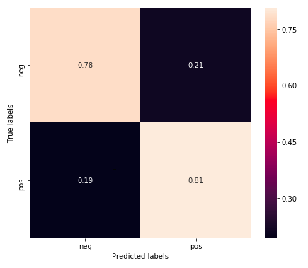
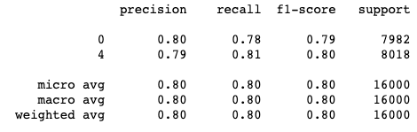
DEMO: sample outputs/results

Slide 7
Analysis of Results
Model | Random Forest | Logistic Regression | Multinomial Naïve Bayes | Stochastic Gradient Descent | XGBoost
Positive Recall | 0.80 | 0.81 | 0.76 | 0.75 | 0.79
Negative Recall | 0.79 | 0.78 | 0.78 | 0.77 | 0.77
Positive Precision | 0.79 | 0.79 | 0.78 | 0.78 | 0.78
Negative Precision | 0.77 | 0.80 | 0.76 | 0.76 | 0.78

Slide 8


Comparison with previous results
While my results only reached about 80% accuracy, most academic/cited papers attained significantly higher accuracy:
Research Paper 1 using Lexicon and Learning was about ~80% accurate across all topics, thus similar to my computed results
Research Paper 3 using unigram feature analysis reached ~91% accurate on some positive recall also on the Twitter Dataset
Neural network sentiment analysis often reached ~95% accuracy on different datasets recognizing sentiment on Amazon or Netflix reviews. These reviews were often 2-3 times as long as the average Tweet in my dataset

Slide 9
Follow-Up and Next Steps
At the moment, my results recognize sentiment somewhat accurately, but not ready to be productionized
Couple of next steps for the project:
Work to clean data: take out stop words, etc.
Reduce dimensions and rerun models: tree-based supervised learning is very slow due to large dimension (278k columns)
Apply Recurrent Neural Network (RNN) for potentially higher accuracy in data, as these gave the best results
Questions from class:
Reduce dimension of massive matrix? Attempted PCA/TruncatedSVD but matrix is too big…

